Slide 1
Hopfield Associative Memories
CSE301 Bio-computation, Week 12, 2016
Bailing Zhang

Slide 2
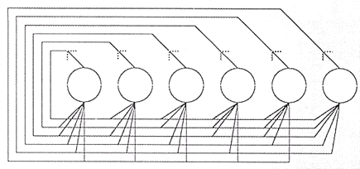
The Hopfield NNs
In 1982, Hopfield, a Caltech physicist, mathematically tied together many of the ideas from previous research.
A fully connected, symmetrically weighted network where each node functions both as input and output node.
Used for
  Associated memories
  Combinatorial optimization
Major contribution of John Hopfield to NN
  Treating a network as a dynamic system
  Introduced the notion of energy function and attractors into NN research

Slide 3
The Hopfield Network (2)
The Hopfield model is a single layer network with full connection
  each node as both input and output units
  node values are iteratively updated, based on the weighted inputs from all other nodes, until stabilized
It is usually initialized with appropriate weights instead of being trained.
The network structure looks as follows:
X₁
X₂
…
X_{N}

Slide 4
The Hopfield Network
Different forms: discrete & continuous
We will focus on the discrete Hopfield model, because its mathematical description is more straightforward.
In the discrete model, the output of each neuron is either 1 or –1.
In its simplest form, the output function is the sign function, which yields 1 for arguments ≥ 0 and –1 otherwise.

Slide 5
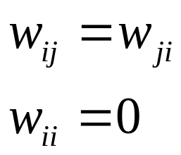
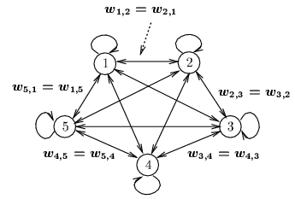
Discrete Hopfield Model as AM
Architecture:
  single layer (units serve as both input and output)
  nodes are threshold units (binary or bipolar)
  weights: fully connected, symmetric, and zero diagonal
  External inputs
  may be transient
  or permanent

Slide 6
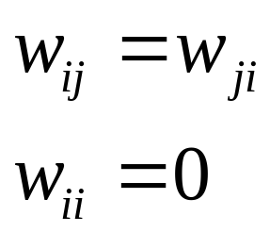
The Discrete Hopfield NNs
_{w1n}
_{w2n}
_{w3n}
_{w13}
_{w23}
_{wn3}
_{w12}
_{w32}
_{wn2}
_{w21}
_{w31}
_{wn1}
. . .
₁
₂
₃
_{n}
_{I1}
_{I2}
_{I3}
_{In}
_{v1}
_{v2}
_{v3}
_{vn}

Slide 7
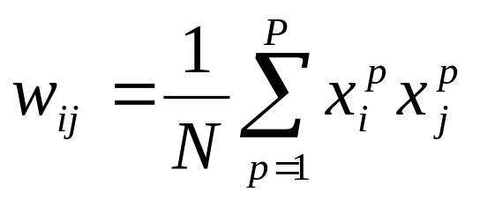
Storage Algorithm
Storage is performed according to the following equation:
The weight matrix is symmetrical, i.e., w_{ij} = w_{ji}.
The constraint condition w_{ii} =0 is important for the network behavior. It can be mathematically proven that under these conditions the network will reach a stable activation state within an infinite number of iterations.

Slide 8
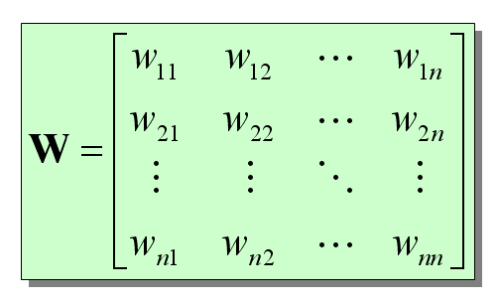
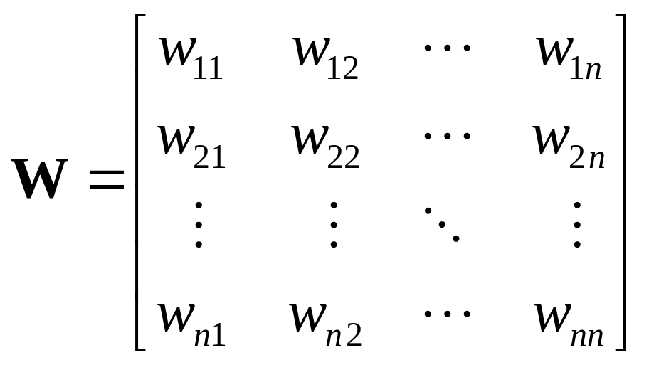
Further Discussion on Storage Algorithm
Suppose the set of stored pattern is of dimension n.

Slide 9
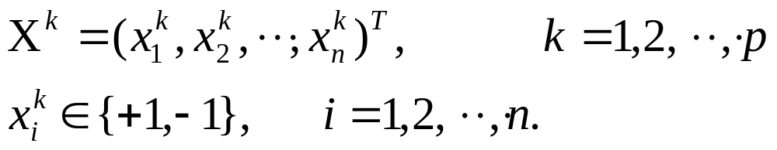
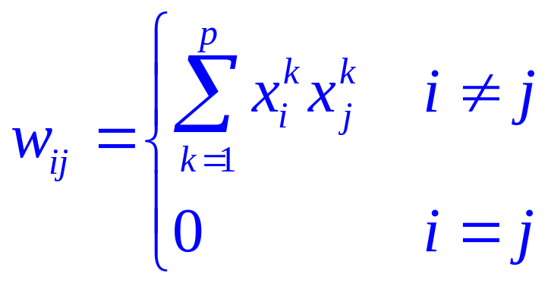
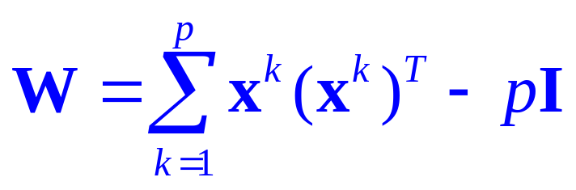
Further Discussion on Storage Algorithm

Slide 10
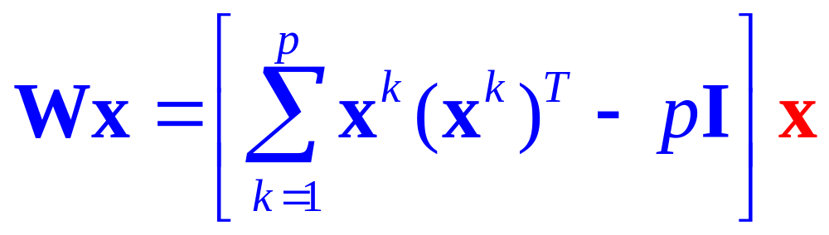
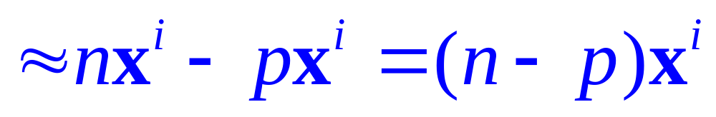
Analysis
Suppose that x ≈ x^{i}.
key, or query
x

Slide 11
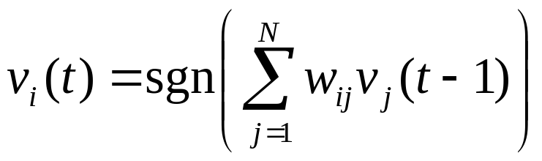
More on Hopfield Network
In the discrete version of the model, each component of an input or output vector can only assume the values 1 or –1.
The output of a neuron i at time t is then computed according to the following formula:
This recursion can be performed over and over again.
In some network variants, external input is added to the internal recurrent one.

Slide 12
More on Hopfield Network
And what does such a stable state look like?
The network associates input patterns with themselves, which means that in each iteration, the activation pattern will be drawn towards one of those patterns.
After converging, the network will most likely present one of the patterns that it was initialized with.
Therefore, Hopfield networks can be used to restore incomplete or noisy input patterns.

Slide 13
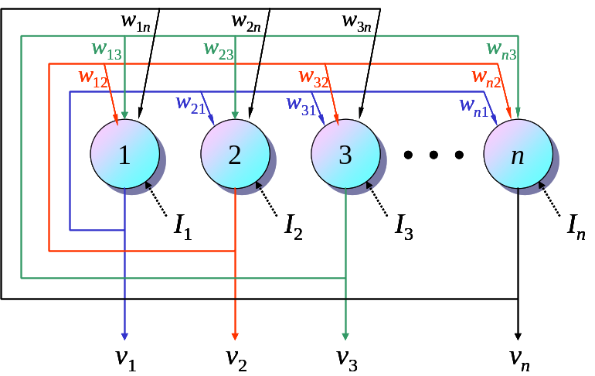
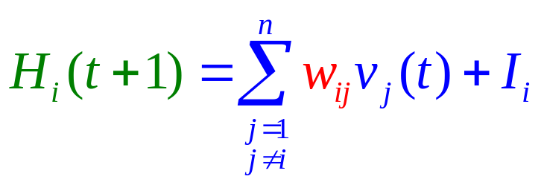
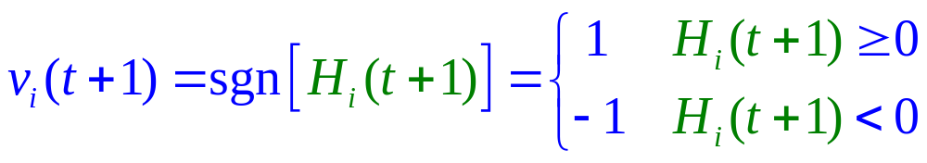
State Update Rule
Asynchronous mode
Update rule
_{Stable?}

Slide 14
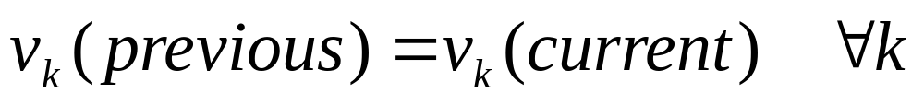
Notes:
  Theoretically, to guarantee convergence of the recall process (avoid oscillation), only one unit is allowed to update its activation at a time during the computation (asynchronous model).
  However, the system may converge faster if all units are allowed to update their activations at the same time (synchronous model).
  Each unit should have equal probability to be selected at
  Convergence test:

Slide 15


Example:
  A 4 node network, stores 2 patterns (1 1 1 1) and (-1 -1 -1 -1)
  Weights:
Corrupted input pattern: (1 1 1 -1)
Node output
selection pattern
node 2: (1 1 1 -1)
node 4: (1 1 1 1)
No more change of state will occur, the correct pattern is recovered
Equal distance: (1 1 -1 -1)
node 2: net = 0, no change (1 1 -1 -1)
node 3: net = 0, change state from -1 to 1 (1 1 1 -1)
node 4: net = 0, change state from -1 to 1 (1 1 1 1)
No more change of state will occur, the correct pattern is recovered
If a different node selection order is used, the stored pattern (-1 -1 -1 -1)
may be recalled

Slide 16
Missing input element: (1 0 -1 -1)
Node output
selection pattern
node 2: (1 -1 -1 -1)
node 1: net = -3, change state to -1 (-1 -1 -1 -1)
No more change of state will occur, the correct pattern is
recovered
Missing input element: (0 0 0 -1)
the correct pattern (-1 -1 -1 -1) is recovered
This is because the AM has only 2 attractors
(1 1 1 1) and (-1 -1 -1 -1)
When spurious attractors exist (with more memories), pattern completion may be incorrect

